Slide 1
Zooniverse Type II Catalog
Xander Hall

Slide 2
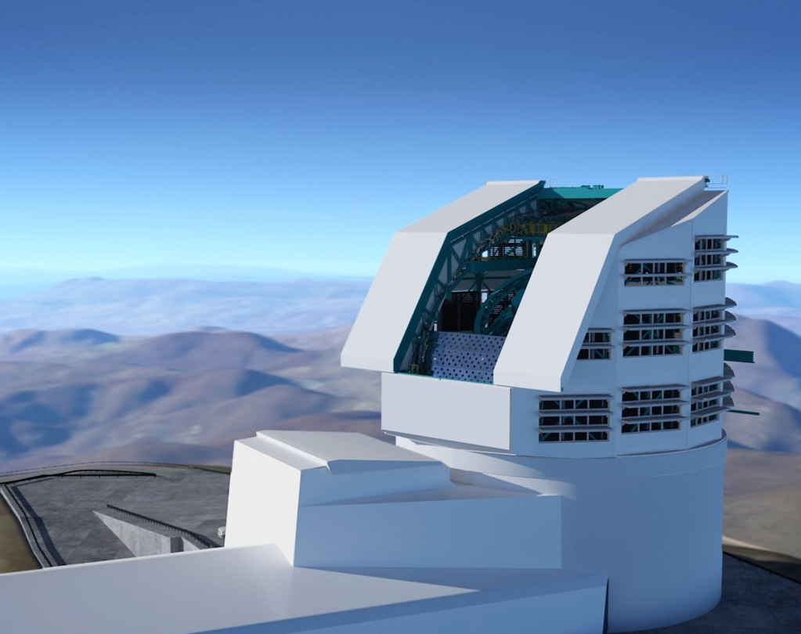
Background
Vera C. Rubin Observatory
8.4m telescope in Chile
Will be able to search the entire night sky every few days
Will find 10,000s new SNe
These SNe need to be followed up on and classified

Slide 3
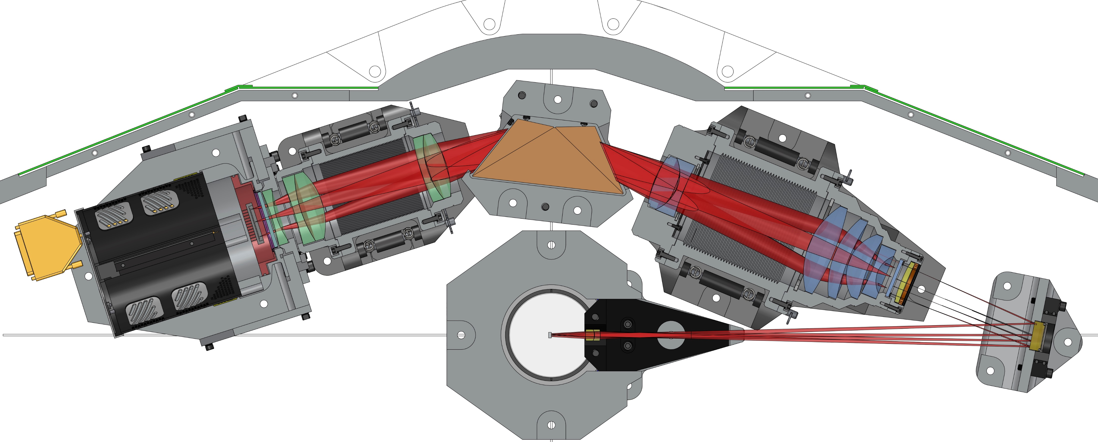
Bright Transient Survey (BTS)
Census of the Local Universe (CLU)
Redshift Completeness Factor (RCF)
Previous work
764 Well Classified Supernova
5095 SNe with 10649 Spectra

Slide 4
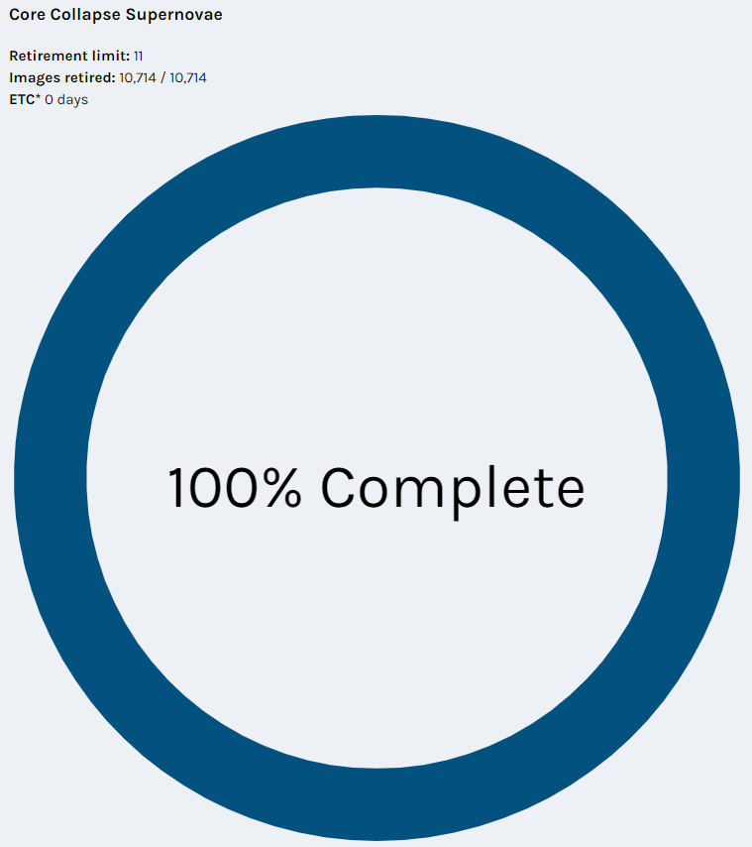
Achieved
Using the Zooniverse we have classified 10,714 spectrum.
This was achieved in ~160 Days
This means that we received about ~730 classification per day
Each spectrum was reviewed by 11 different volunteers

Slide 5
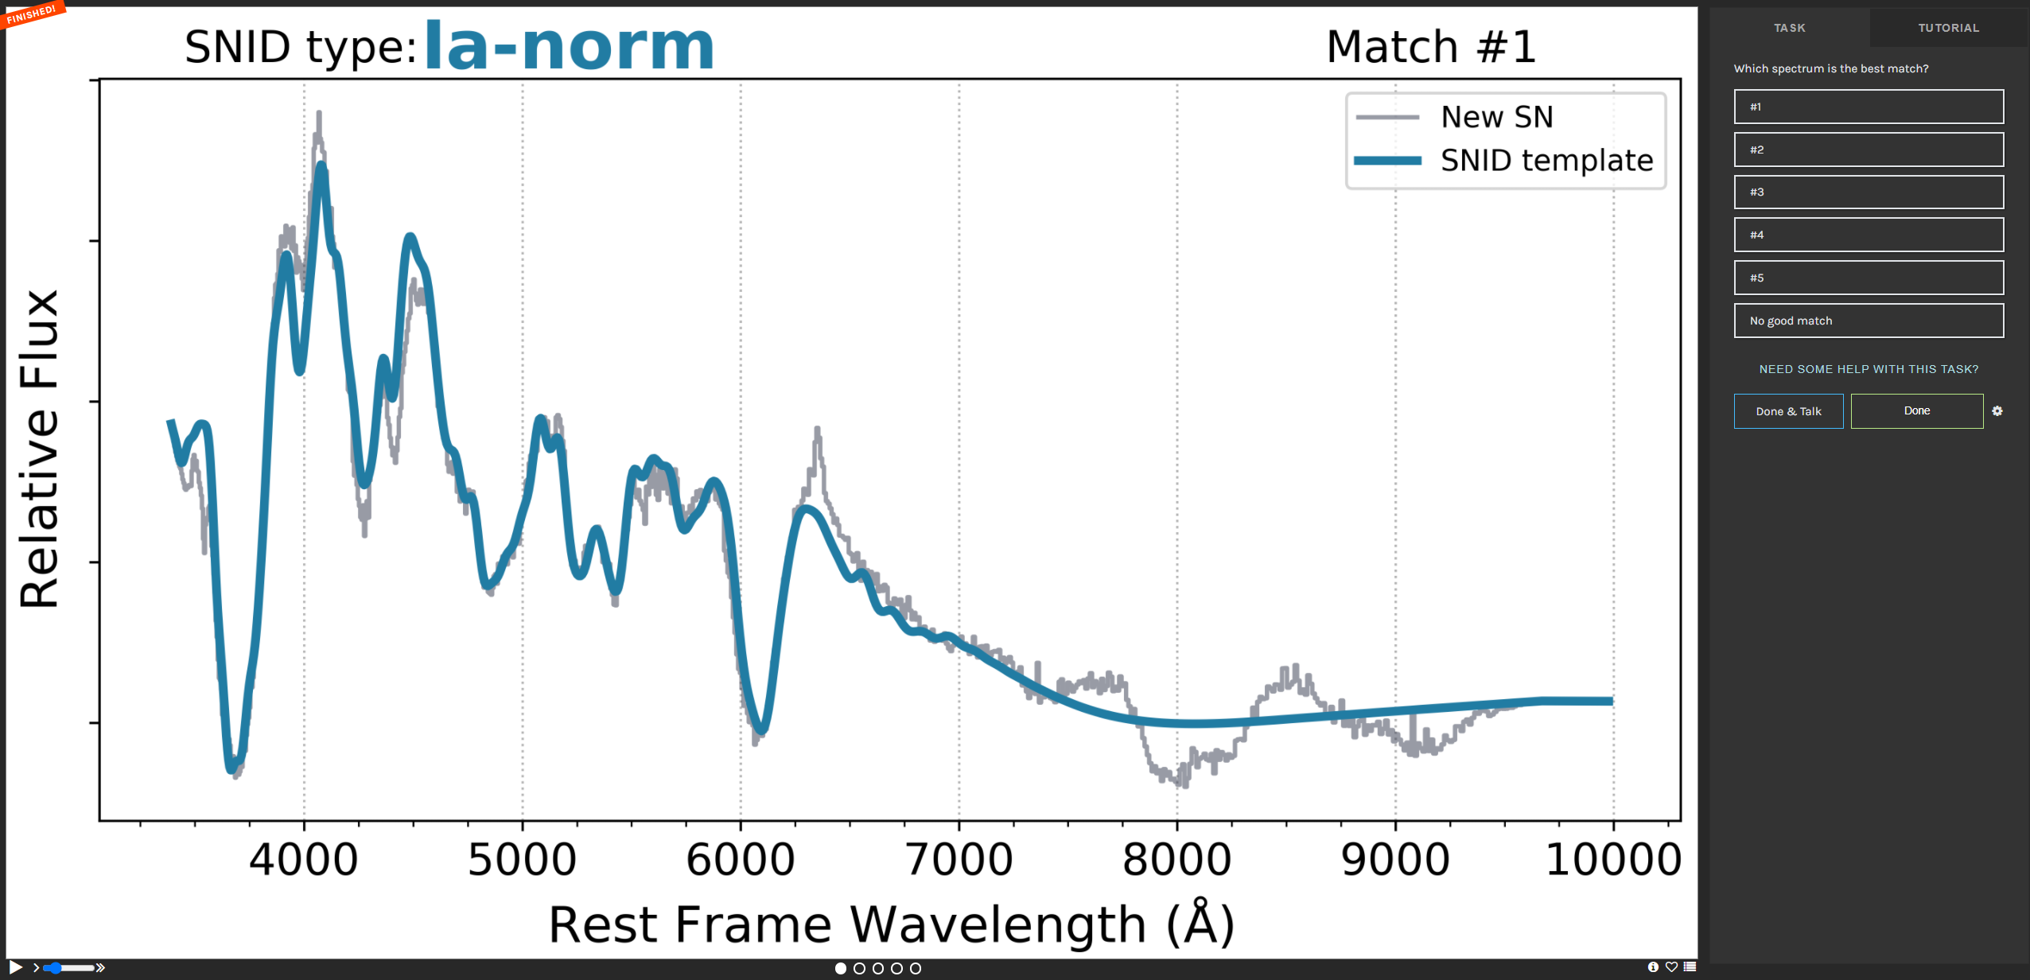
Process
Run every spectrum through SNID.
Graph the template results of the “top 5” matches.
Let volunteers decide the best match.
Run Superfit on the spectrum.
If Superfit and 6 volunteers agree it is a Type II we can confidently say it is a Type II

Slide 6
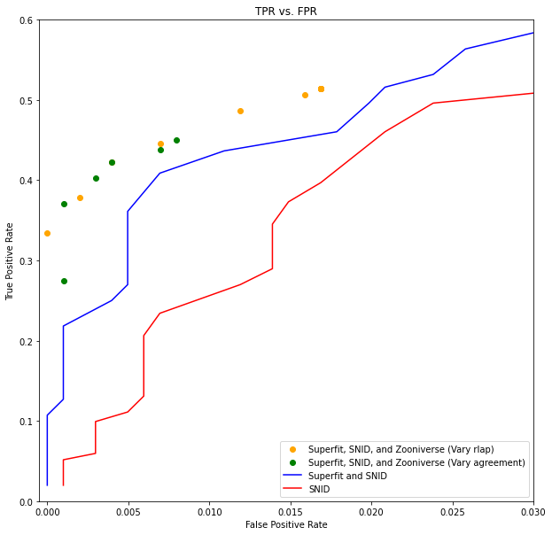
Results
Using ~700 SNe from the first RCF paper we can conclude that we achieve ~50% TPR at a 0.5% FPR.
This means we found ~36 Type II SNe
The Volunteers and Superfit perform about 10% better than just SNID and Superfit alone.
This all done if just one of the spectrum received is classified as a Type II

Slide 7
Using the Zooniverse
Built an automated bot (Matt Chu).
Take a new spectrum from the Marshall.
Run this through SNID and Superfit.
Upload the SNID templates to Zooniverse.
Download the Zooniverse classifications.
If it passes the requirements upload a classification to TNS as a Type II.

Slide 8
In Progress
Release a paper listing these classification and the process.

